Slide 1
App Services
A Developer's Guide to
Windows 10 Insider Preview Andy & Jerry

Slide 2
Agenda
What are App Services?
App Services Scenarios
App Services Client
App Services Server
Debugging Tips
Debugging an App Service
App Services Details
App Service Lifetime
Implementing a client SDK
Controlling Access
Versioning

Slide 3
With App Services, store applications can provide services to other store applications
Notes:
App Services is a way for store applications to register support for application contracts (i.e. an API) that they are willing to service. Other store applications can then leverage these application contracts to help users perform tasks that would otherwise require the user to go in and out of multiple applications.

Slide 4
What are App Services?
UWP offers many APIs that allow apps to interact with the platform
Windows.ApplicationModel.Contacts
Windows.ApplicationModel.Email
Windows.System.Launcher.LaunchUriAsync to launch settings, maps, store etc…
more…
UWP also allows apps to interact with each other
Uri Associations using LaunchUriAsync
File associations using LaunchFileAsync
Launch for results using LaunchUriForResultsAsync
App Services
Notes:
LaunchForResults and App Services are very much complementary technologies.
You could think of App Services as being a UI-less LaunchForResults, but with the added capability of the App Service being potentially long-lived and supporting a chatty communication interaction.

Slide 5
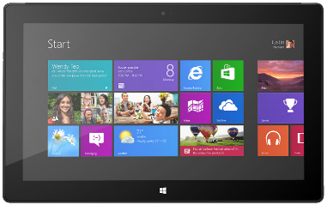
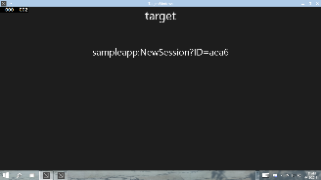




Think ‘Web Services on device’
Client App A
App with App Service
Background Task
Client App B

Slide 6

Scenario: Bar Code Scanning
Bar Code decoding App Service
Image bytes in ValueSet or FileToken
Decoded data

Slide 7
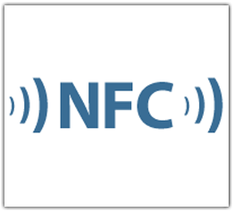
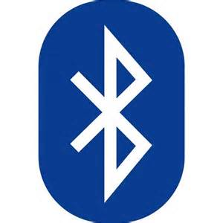
Scenario: Enterprise suite of apps
Client App A
App Service
Maintains Inventory cache
Interact with cloud services
Client App B
App Service
Proximity Reading Services
Notes:
In scenarios where the apps talking to each other are known to each other these features can be used to drive complex user tasks that span across multiple apps. For example, the ability to invoke a particular app and get return values from the invocation – whether that’s foreground apps using LaunchForResults or background tasks using App Services - could be used to drive an SSO mechanism. Another example is an enterprise or publisher with a suite of apps each of which provides a subset of the functionality a user might use while performing their day to day tasks. The suite of apps scenario in particular is very common across our enterprise customers .

Slide 8
App Services – Client
AppServiceConnection connection = new AppServiceConnection(); connection.AppServiceName = "microsoftDX-appservicesdemo"; connection.PackageFamilyName = "24919ArunjeetSingh.InstapaperIt"; AppServiceConnectionStatus connectionStatus = await connection.OpenAsync(); if (connectionStatus == AppServiceConnectionStatus.Success) { //Send data to the service var message = new ValueSet(); message.Add("Command", "CalcSum"); message.Add("Value1", Int32.Parse(Value1.Text)); message.Add("Value2", Int32.Parse(Value2.Text)); //Send message and wait for response AppServiceResponse response = await connection.SendMessageAsync(message); if (response.Status == AppServiceResponseStatus.Success) { int sum = (int)response.Message["Result"]; new MessageDialog("Result=" + sum).ShowAsync(); } } else { //Drive the user to store to install the app that provides the app service }
Notes:
The client creates an AppServiceConnection and then calls the SendMessageAsync API to send a message (a ValueSet) and (optionally) receive a response (also a ValueSet).

Slide 9
App Services – Service (1/2)
namespace AppServicesDemoTask { public sealed class AppServiceTask : IBackgroundTask { private static BackgroundTaskDeferral _serviceDeferral; public void Run(IBackgroundTaskInstance taskInstance) { // Associate a cancellation handler with the background task. taskInstance.Canceled += TaskInstance_Canceled; // Get the deferral object from the task instance _serviceDeferral = taskInstance.GetDeferral(); var appService = taskInstance.TriggerDetails as AppServiceTriggerDetails; if (appService.Name == "microsoftDX-appservicesdemo") { //Maybe ValidateCaller(appService.CallerPackageFamilyName) ?? appService.AppServiceConnection.RequestReceived += RequestReceived; } } ...
Notes:
The service also gets an AppServiceConnection when it is Run. It uses this RequestReceived event on the AppServiceConnection to listen for incoming messages.

Slide 10
App Services – Service (2/2)
private async void RequestReceived(AppServiceConnection sender, AppServiceRequestReceivedEventArgs args) { var message = args.Request.Message; // This service uses a Command keyed entry for the client to invoke services from the App Service string command = message["Command"] as string; switch (command) { case "DoIt": { var messageDeferral = args.GetDeferral(); int value1 = (int)message["Value1"]; ... Do some processing //Set a result to return to the caller var returnMessage = new ValueSet(); returnMessage.Add("Result", result); var responseStatus = await args.Request.SendResponseAsync(returnMessage); messageDeferral.Complete(); break; } case "Quit": { //Service was asked to quit. Complete service deferral so platform can terminate _serviceDeferral.Complete(); break; } } }
Notes:
It uses this RequestReceived event handler to respond to incoming messages.
The wonderful thing is that the connection is two-way. The Client could also listen for messages by using the AppServiceConnection it set up. The AppService lives for as long as the client is alive. There are no lifetime limits to the app service itself.
Some other points to consider:
* Client or service code can cancel a SendMessageAsync either explicitly or using a timeout using standard IAsyncOperation methods after the Message event handler on the other side has started running. In such a case the event handler should continue running. If the client does want to stop the application service it can dispose the AppServiceConnection reference it has.
* Calling AppServiceRequestReceivedEventArgs.Request.SetResponseAsync is optional. An app service endpoint does not HAVE to return a response.
* The client or service can start sending messages using SendMessageAsync before the other side has had the opportunity to hook up its Message handler. In such cases we will buffer messages in the process of the SendMessageAsync caller until such time as they can be delivered. Until the message is delivered or a cancellation timeout (if one was set up) is hit, the SendMessageAsync asynchronous operation will not be marked completed. If you’re pumping messages and the other side isn’t listening you’re not causing harm to anyone but yourself.

Slide 11
Declaring App Service
<?xml version="1.0" encoding="utf-8"?> <Package xmlns="http://schemas.microsoft.com/appx/manifest/foundation/windows10" ... >
<Applications> <Application Id="App“ ... > <Extensions> <uap:Extension Category="windows.appService“ EntryPoint="AppServicesDemoTask.AppServiceTask"> <uap:AppService Name="microsoftDX-appservicesdemo" /> </uap:Extension> </Extensions> </Application> </Applications> <Capabilities> <Capability Name="internetClient" /> </Capabilities> </Package>

Slide 12
Two-way Communication
Client and server can keep a two-way chatty communication channel open
Client can attach a RequestReceived event handler to its own AppServiceConnection instance
Both client and server can send and receive messages
AppServiceConnectionStatus connectionStatus = await connection.OpenAsync(); if (connectionStatus == AppServiceConnectionStatus.Success) { connection.RequestReceived += OnRequestReceived; }
Notes:
The fact that the client has control over the lifetime of the application service and can keep a chatty communication channel open with it is a key differentiator for message-based application services over Http-based services. Also important is the fact that message-based services allow for exchange of arbitrary byte buffers embedded in the ValueSet messages exchanged between client and service.

Slide 13
Debugging Tips
Getting the PackageFamilyName for the App Service
Debugging your App Service

Slide 14
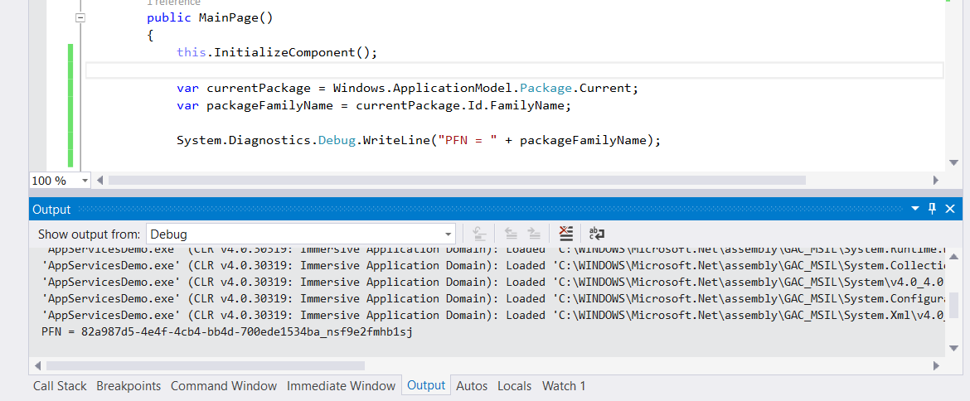
Getting the Service PackageFamilyName
Later on, ‘Store – Associate App with the Store’ sets the correct PackageFamilyName
In Tech Preview, Store not open yet for UAP Call Package.Current.Id.FamilyName to return PFN to use in debugging

Slide 15
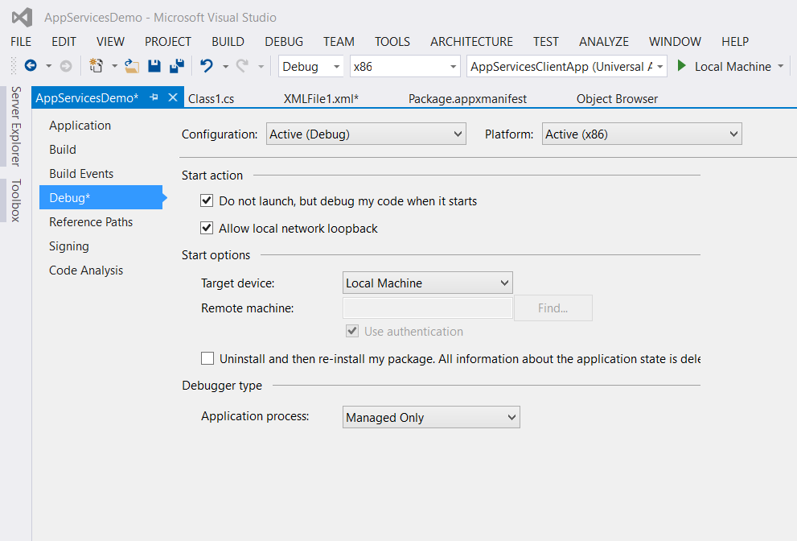
Debugging App Services
Set breakpoints in app service code
Check ‘Do not launch but debug my code when it starts’ in project properties
Launch app service foreground app in debugger – nothing happens!
Run client app to connect to app service
Debugger attaches and breaks on your breakpoint

Slide 16
App Services

Slide 17
More considerations on App Services…

Slide 18
App Service Lifetime
Service is activated on-demand
Background Task activated by means of an AppServiceTrigger
Client may terminate service by disposing its AppServiceConnection or by sending a message instructing service to shutdown
If the invoking app is suspended, app services sponsored by the app will be terminated
Insufficient resources may cause launch failure or service termination
Invoking app will get AppServiceConnectionStatus.ResourcesNotAvailable when connecting
My get AppServiceResponseStatus.ResourceLimitsExceeded when sending message
Notes:
It is important to note that the lifetime of the application service is also tied to the lifetime of the invoking application. If the invoking application is suspended any application services it opened will also be suspended. To reclaim memory, we might even cancel and terminate application services sponsored by the application while the application is suspended. In situations like that, the application will get an OnClosed event after it comes back from suspension. Conversely, as long as the invoking application is running (even if it isn’t in the foreground) we should try and keep any app services it sponsors alive.

Slide 19
What Protocol?
App Services are designed to be flexible and light-weight and are modelled on web REST Web services
Simple Request-Response message API
Data packaged as string-keyed ValueSets
Easy to use with multiple different payloads
When you publish an App Service, you are defining a communications endpoint
An App Service endpoint provides the Caller a way to send data to the Callee
An App Service endpoint also provides the Caller a way to request return values from the Callee and for the Callee to respond with these return values.

Slide 20
App services provides another way for applications to communicate with each other
Notes:
App Services is a way for Windows Universal applications to exchange messages with each other. These messages can then be used by an application to invoke another application to perform a task (defined by the protocol that you devise) on its behalf and optionally, return data. Using App Services and LaunchForResults, applications can help the user complete complex tasks that might otherwise require the user to shuttle in and out of multiple applications.

Slide 21
Implementing a Client SDK ☺
Wrap the low-level service communication implementation details inside a more functional set of methods
Publish a client SDK for your service
Distribute as a NuGet package or by other means

Slide 22
Can I restrict access to my App Service?
Build your own caller validation mechanisms on top of app services
Simplest is for service provider to whitelist callers based on their PackageFamilyName
PackageFamilyName of caller is passed with every request
Possible to build more complicated caller validation mechanisms on top of ValueSets once a connection has been established
Whitelist could be followed by explicit X.509 certificate exchange

Slide 23
Versioning
Follow the Web REST API versioning model
If you need to make a breaking change to an App Service endpoint, you must expose a new endpoint and provide backward compatibility with the old one
Notes:
Here's a good starting point if you want to get deeper into REST API vesioning: http://codebetter.com/howarddierking/2012/11/09/versioning-restful-services/

Slide 24
App Services client library

Slide 25
Review
What are App Services?
App Services Scenarios
App Services Client
App Services Server
Debugging Tips
Debugging an App Service
App Services Details
App Service Lifetime
Building a client API
Controlling Access
Versioning

